Slide 1
Seasonal and Interannual Variability of Bay of Bengal SST: A Robust EOF Approach
By
Sutesna Mondal

Slide 2
Table of contents
01
02
03
Introduction
What is EOF
Data Resources

Slide 3
04
05
06
Technology
Demonstration
Conclusion

Slide 4
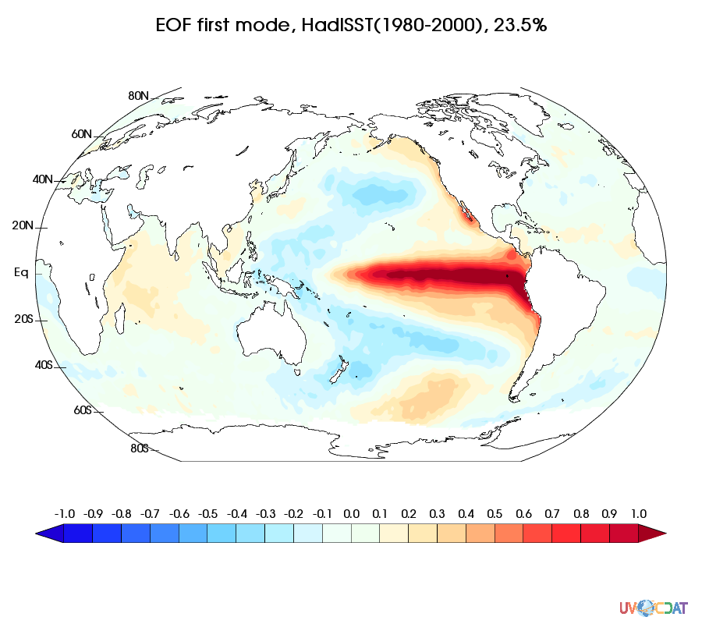
Introduction
Empirical orthogonal function (EOF) analyses are used to study climate variability patterns and their temporal evolution. The eigenvectors of a spatially weighted anomaly covariance matrix provide a basis for calculating variance explanations. These EOFs represent space-time physical processes, with the largest variance attributed to the first pattern.

Slide 5
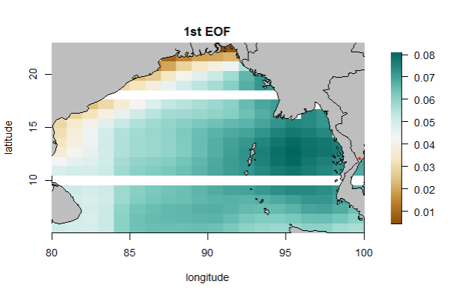
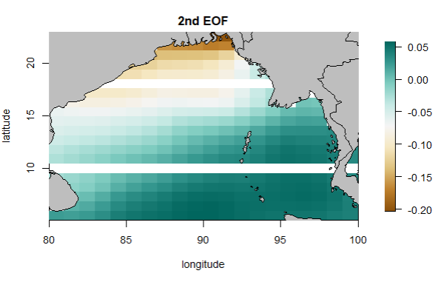
What is EOF

Slide 6
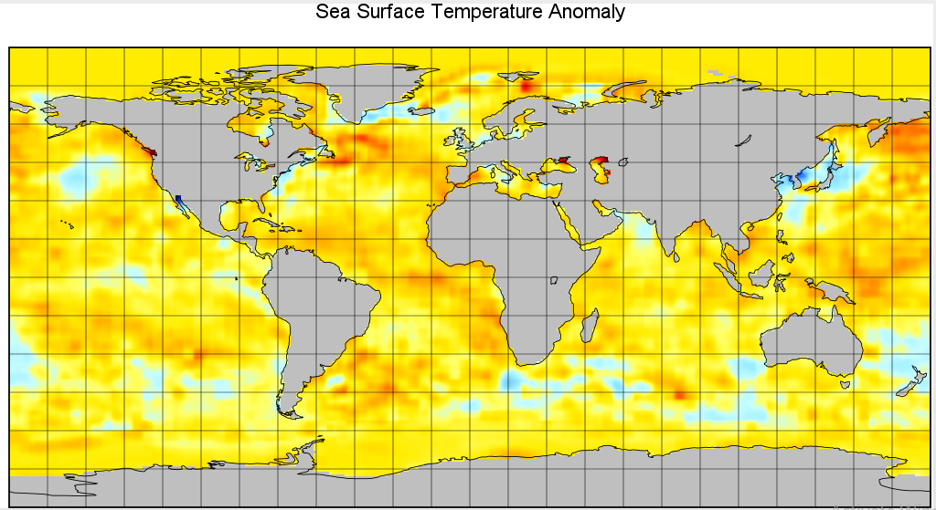
Data Resources

Slide 7

Technology
R libraries
R Studio
Ncdf4 , maps , fields,
RColorBrewer
For implementation

Slide 8
Demonstration

Slide 9
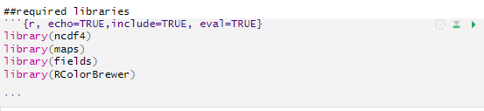
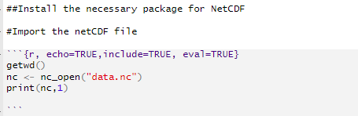

Slide 10
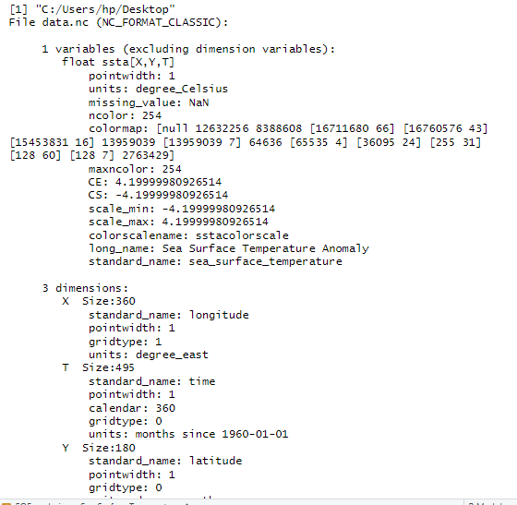

Slide 11
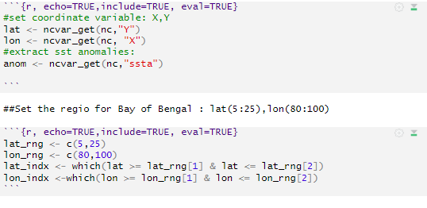
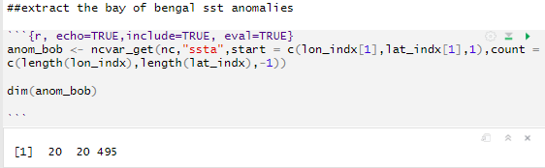

Slide 12
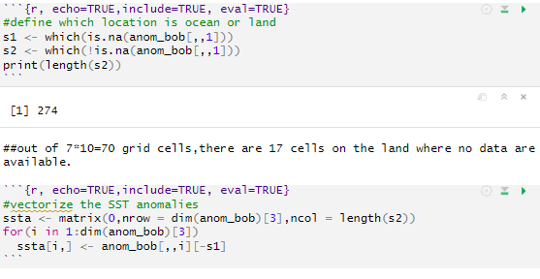

Slide 13
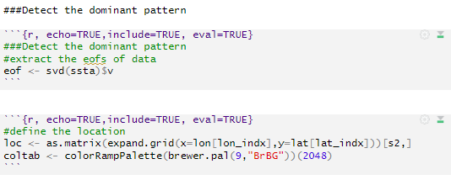

Slide 14
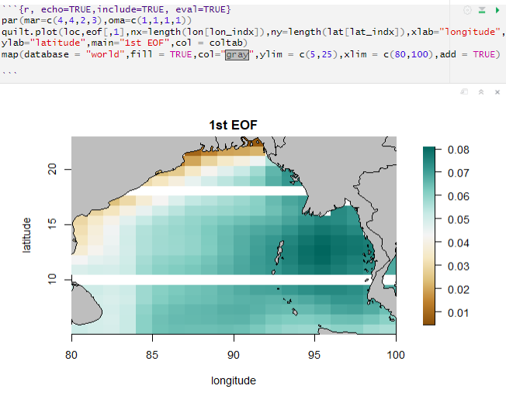

Slide 15
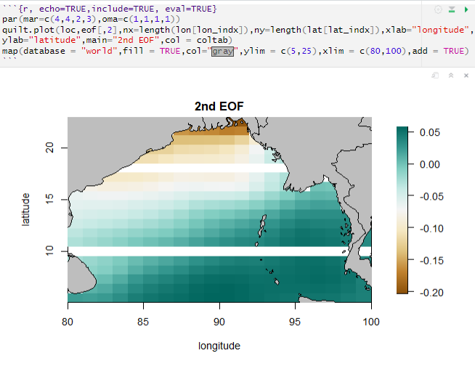

Slide 16
Thanks !

